Slide 1
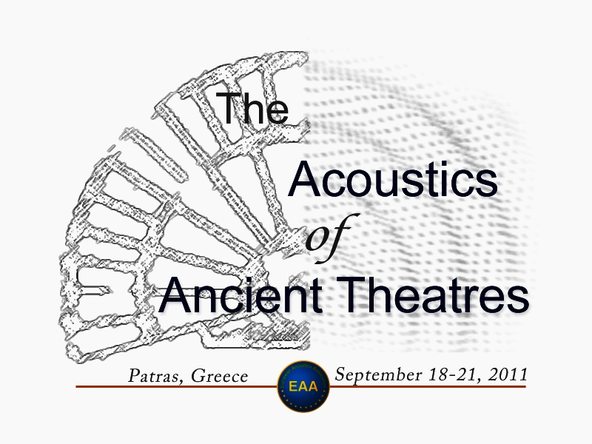
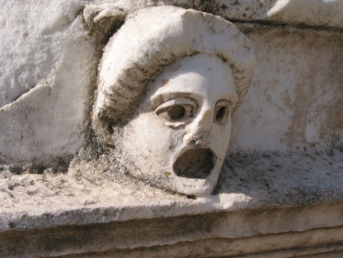
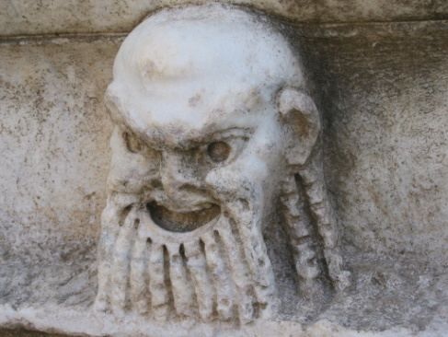
Echo problems in ancient theatres and a comment to the ‘sounding vessels’ described by Vitruvius
Jens Holger Rindel
Odeon A/S, Denmark

Slide 2
Outline
Sound reflections in a theatre
Echo positions in a Roman theatre
Vitruvius and his background
Theatre design in the 1st century BC
The sounding vessels - Aristoxenus
Conclusion

Slide 3
Sound reflections in the theatre
Vitruvius (Book V,viii,1) describes four different kinds of sound reflections:
‘dissonant’
  disturbing reflection from above
‘circumsonant’
  focusing (sound is forced into the middle)
‘resonant’
  echo (word endings sound double)
‘consonant’
  supporting reflection from below

Slide 4
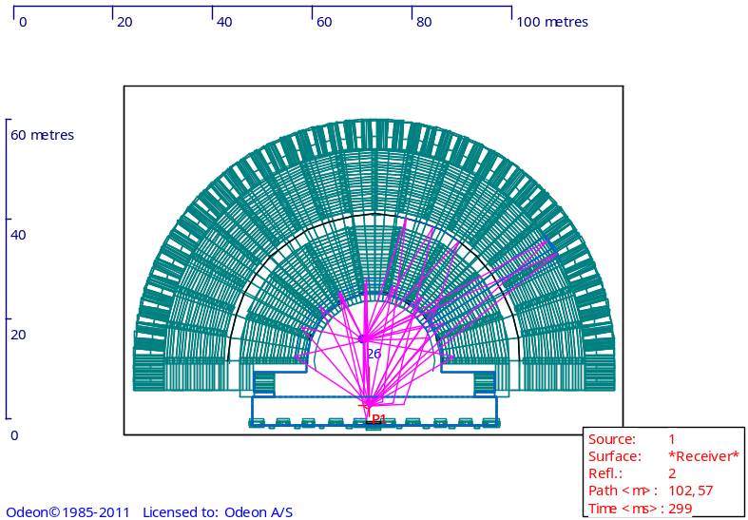
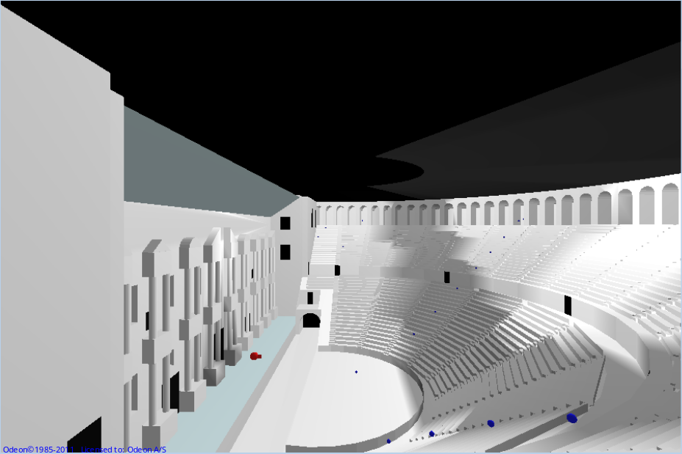
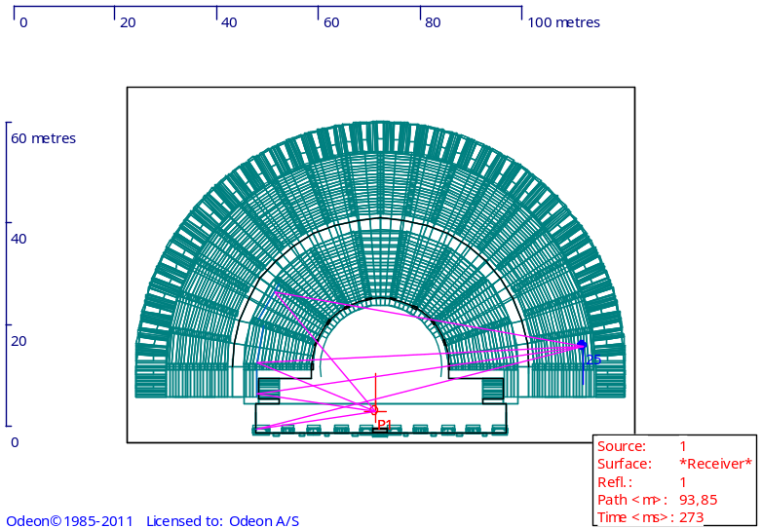
‘Circumsonance’ in a Roman theatre
Aspendos theatre, virtual reconstruction

Slide 5
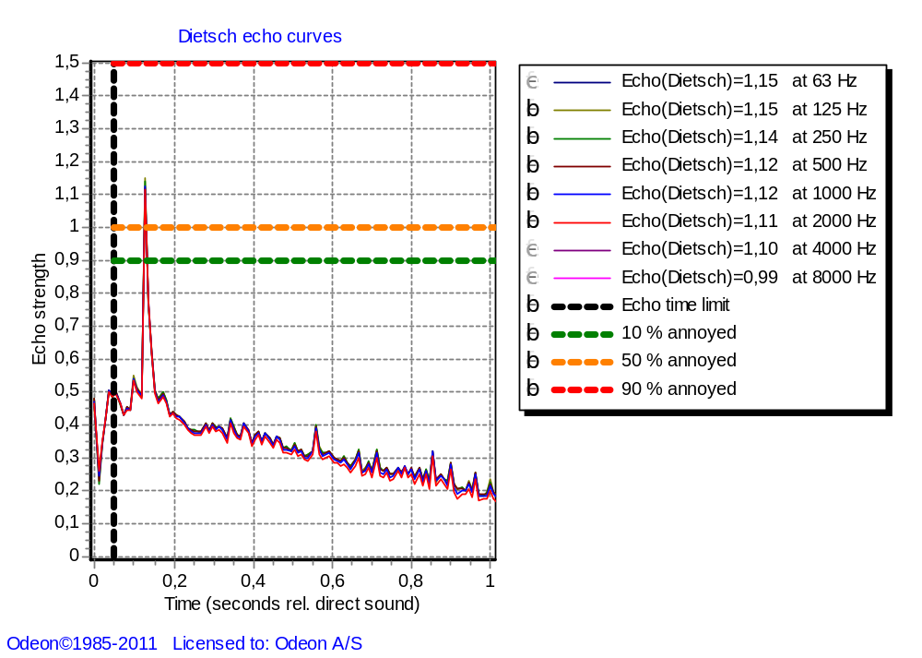
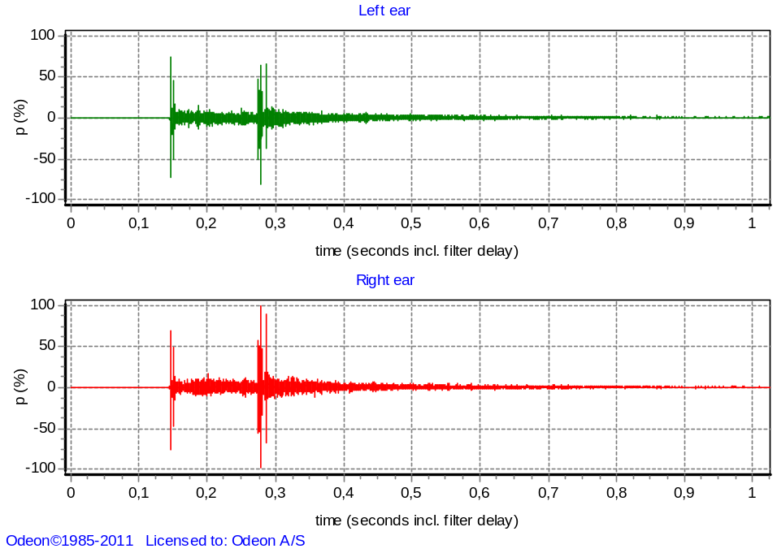
Echo (Dietsch) parameter
Impulse response

Slide 6
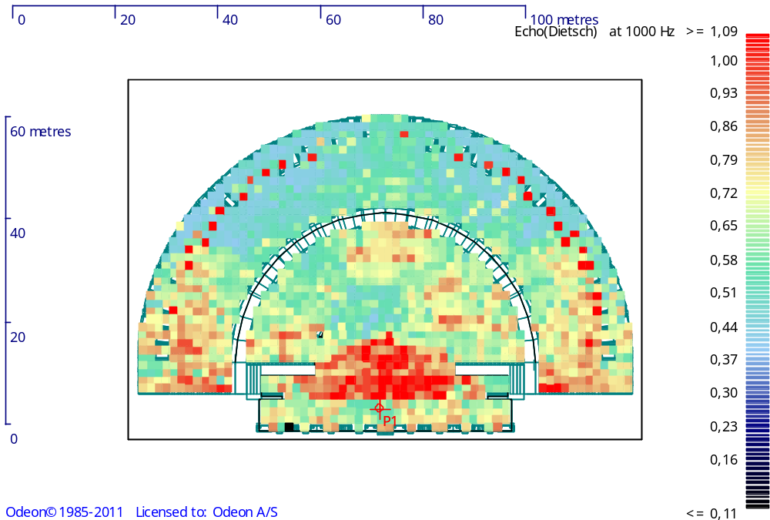
Echo (Dietsch) parameter

Slide 7
Vitruvius and his background
Born around 80 BC
‘Ten books on architecture’ probably finished around 16-13 BC [Bieber]
Draws extensively on older, mainly Greek writings (Book VII, introduction, 14):
  From their commentaries I have gathered what I saw was useful for the present subject, and formed it into one complete treatise, and this principally, because I saw that many books in this field had been published by the Greeks, but very few indeed by our countrymen.

Slide 8
Development of theatre design in the first century BC
In the capital Rome only theatres of wood were allowed
  However, Pompejus built a theatre in Rome 61 – 55 BC (claiming it was a temple)
  The Marcellus theatre in Rome finished 13 or 11 BC, but used already from 17 BC

Slide 9
Development of theatre design in the first century BC
Pompeii became a Colony in 80 BC. The city was rich and new theatre types were created:
  Hellenistic theatre from 3rd – 2nd century
  Odeion – “Teatrum tectum” (the first of its kind) ca. 75 BC
  Amphitheatre (the first of its kind) ca. 70 BC – in Italy the traditional gladiator fights had been held in the Agora (Vitruvius, Book V,i,1)

Slide 10
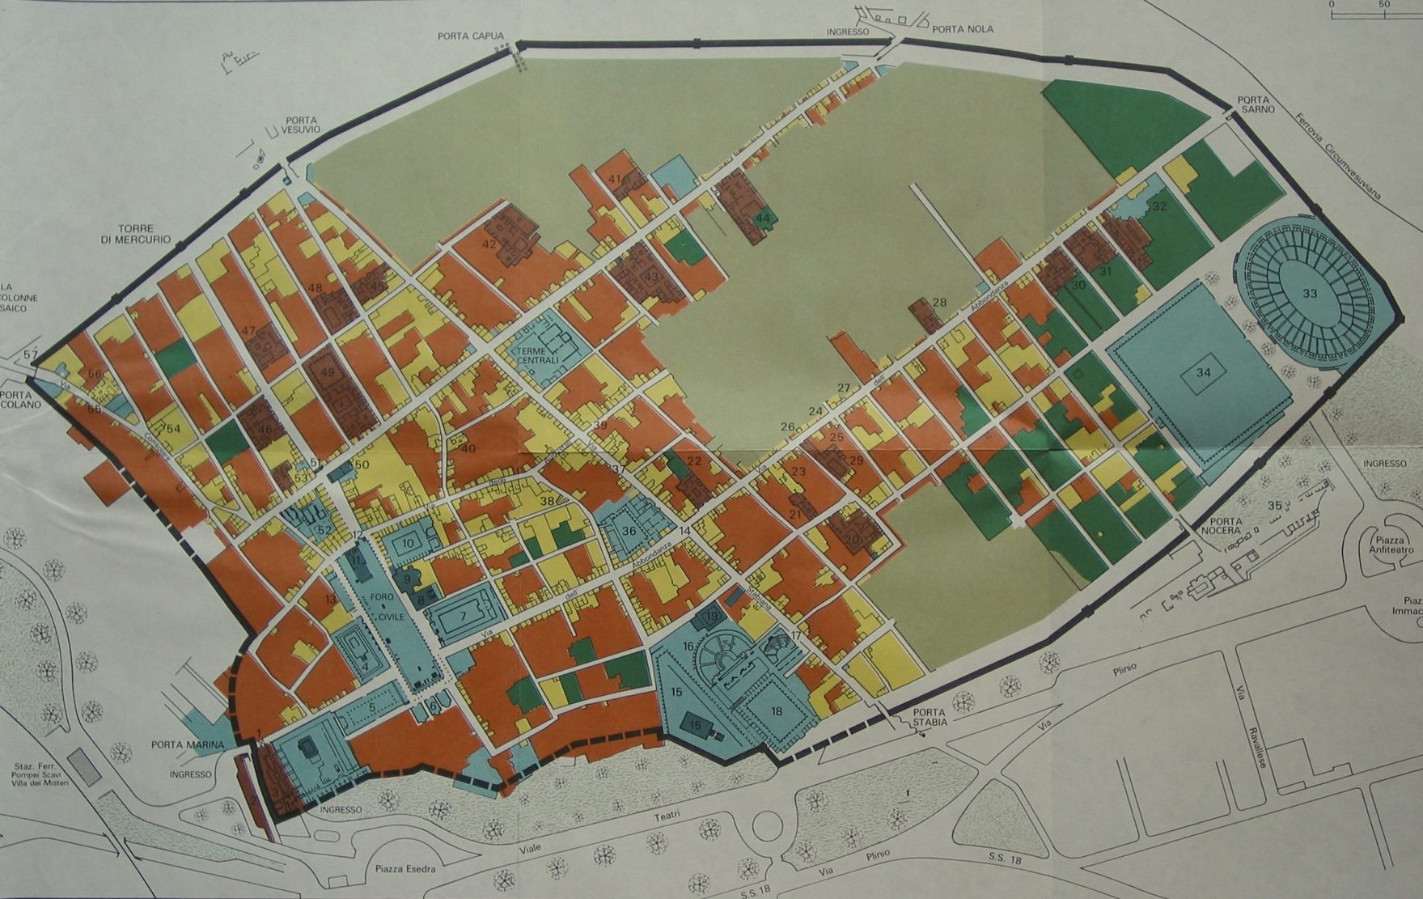
Pompeii, city plan
Amphitheatre
Theatre
Odeion

Slide 11
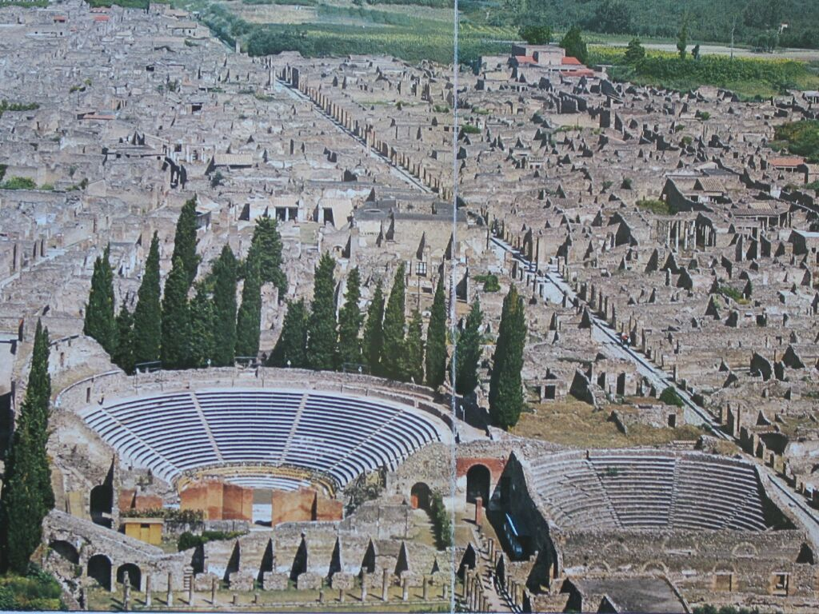
Theatre and Odeion in Pompeii

Slide 12
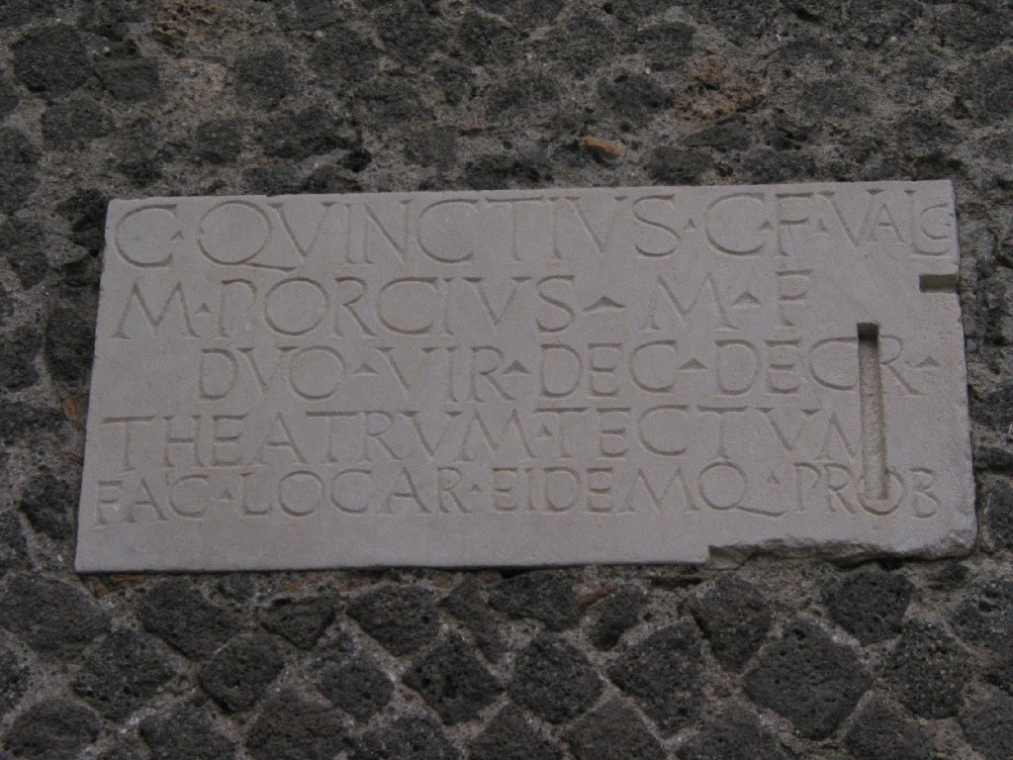
Inscription on Theatrum tectum

Slide 13
The first amphitheatre and odeion in Rome
In 29 BC the gladiator fights in Rome were moved to an amphitheatre built from wood
The Flavian Amphitheatre (Colosseum) was built AD 75 – 80
Only one odeion was built in Rome by Domitian in AD 86
So, Vitruvius was not familiar with these theatre types, although they existed outside Rome

Slide 14
Vitruvius and theatres
Vitruvius gives design guides in Book V of the Greek theatre (which was a type not being build any more) and the Roman theatre, but he says nothing about the new types, the amphitheatre and the odeion.
Was Vitruvius up-to-date in theatre design?
  No, obviously not. He was never involved in building a theatre himself.
He relies heavily on older, mainly Greek descriptions.

Slide 15
The sounding vessels
Vitruvius (Book I,i,9):
In theatres, likewise, there are the bronze vessels (in Greek ηχεια) which are placed in niches under the seats in accordance with the musical intervals on mathematical principles. These vessels are arranged with a view to musical concords or harmony, and apportioned in the compass of the fourth, the fifth, and the octave, and so on up to the double octave, in such a way that when the voice of an actor falls in unison with any of them its power is increased, and it reaches the ears of the audience with greater clearness and sweetness.

Slide 16
The sounding vessels
Vitruvius (Book V,v,3):
By the adoption of this plan, the voice which issues from the scene, expanding as from a centre, and striking against the cavity of each vase, will sound with increased clearness and harmony, from its unison with one or other of them. (Bill Thayer, translation)

Slide 17
The sounding vessels
Vitruvius (Book V,v,7):
- there is no need for the sounding vessels in the wooden theatres that were built every year in Rome, because the boarding itself is resonant –
But when theatres are build of solid materials like masonry, stone or marble, which cannot be resonant, then the principle of the “echea” must be applied.
  (echea – sounders)

Slide 18
Aristoxenus
The idea and theory behind the sounding vessels goes back to the ancient Greek music theoretician and philosopher Aristoxenus [Vitruvius, Book V.v.6].
Aristoxenus lived in Athens around 350 BC, was a pupil of Aristoteles, and wrote a large number of treatises on topics within music, ethics and philosophy.

Slide 19
Existence of sounding vessels (1)
Obviously Vitruvius has never seen them himself; but he gives one specific reference (Book V.v.8):
“We have also the evidence of Lucius Mummius, who, after destroying the theatre in Corinth, brought its bronze vessels to Rome.”
It is a fact that Lucius Mummius was a Roman general who conquered Corinth in 146 BC, demolished the city and brought lots of treasures to Rome.
The theatre was a Hellenistic theatre from the 3rd century BC. The time and location fit with Aristoxenus

Slide 20
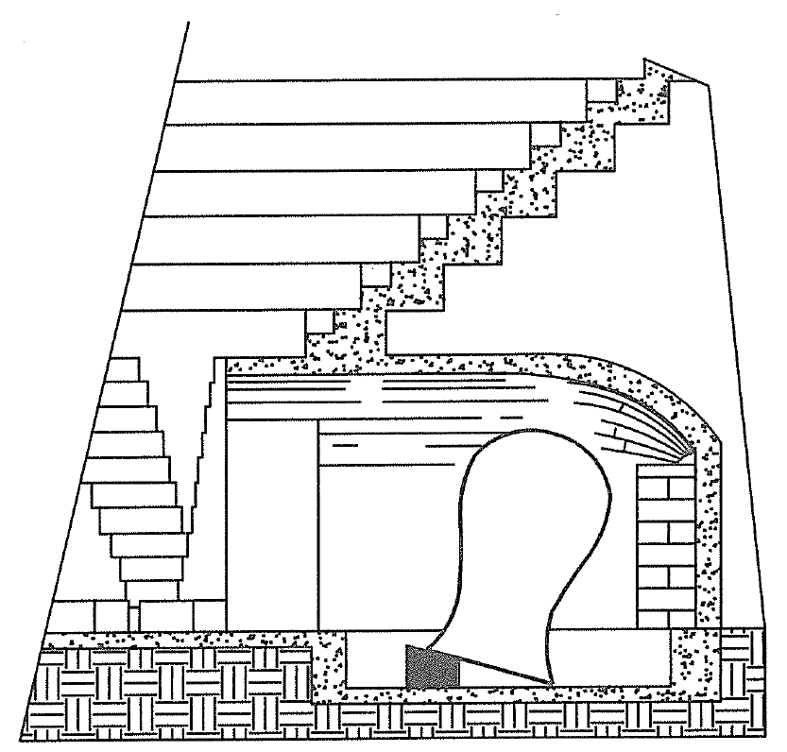
Existence of sounding vessels (2)
Izenour (1977) described the existence of cavities in the a Roman theatre in Beth Shean, Israel.
The cavities may have accommodated sounding vessels.
The number is not correct (only nine, should be 13)

Slide 21
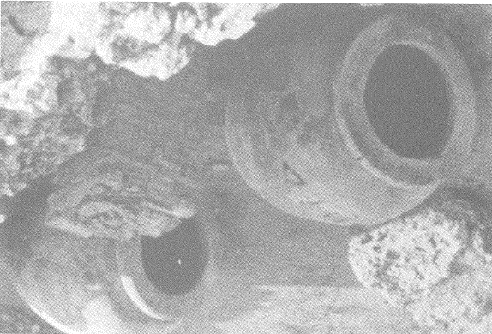
Existence of sounding vessels (3)
Clay vases found in a theatre at Nora, Sardinia in 1958 (Brüel, 2005).

Slide 22
Conclusion
The idea and the guidelines for the sounding vessels goes back to Aristoxinus in the 4th century BC, i.e. about 300 years before Vitruvius
The purpose might have been to attenuate sound reflections from a concave surface that could create a focused echo, ‘circumsonance’
In theory it makes sense to use resonators tuned to different frequencies, together covering a range of two octaves (220 – 880 Hz)
The sounding vessels could not possible make any improvement to the acoustics in practice,

